Slide 1


From Communicate to Collaborate:
A Roadmap for Success
Tom Gill, VP and CIO

Slide 2
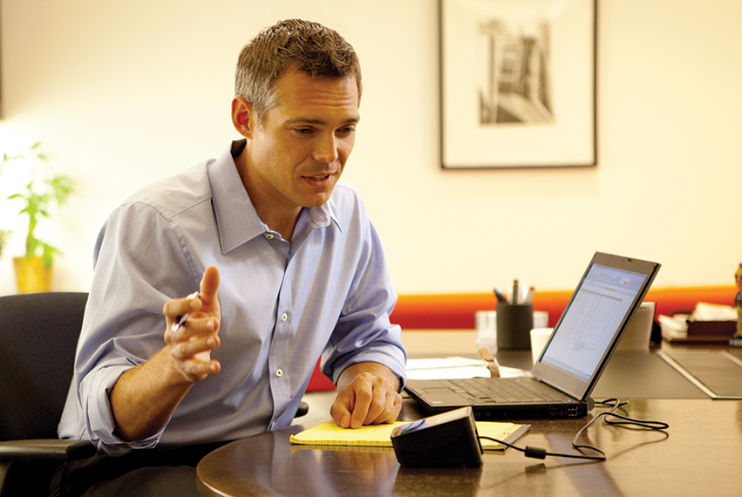
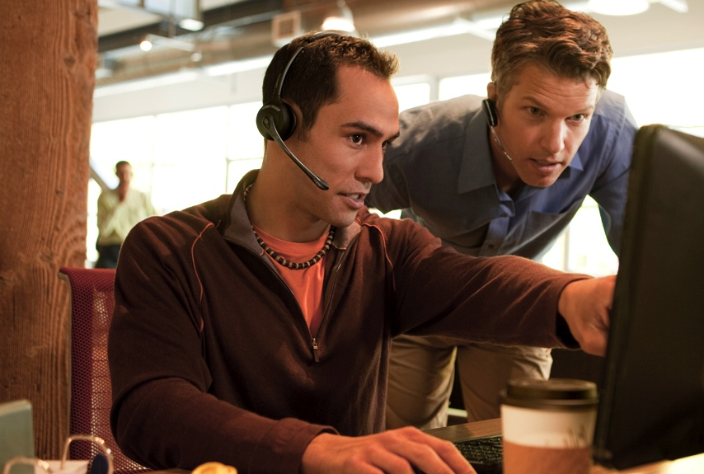

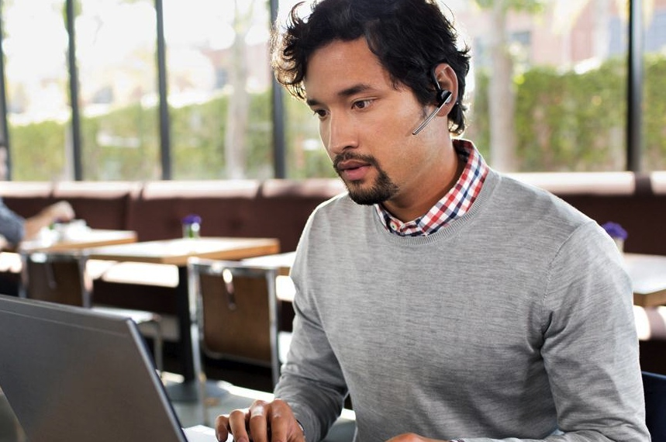
Blurred Lines
Work. Personal. Life.

Slide 3
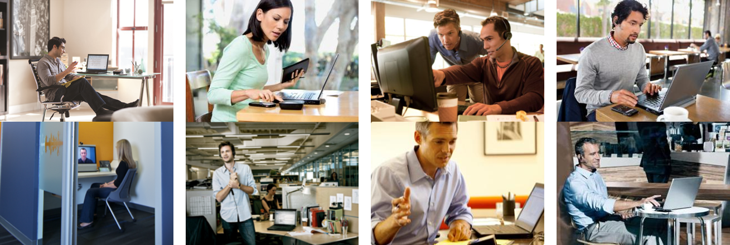
Work Environments are Changing
Communicate + Collaborate is the New Normal

Slide 4
Choice Drives Performance and Innovation
Employers who provide a spectrum of choices for when and where to work are seen as more innovative and have higher-performing employees.
Courtesy: Gensler 2013 U.S. Workplace Survey

Slide 5
Effective Workplaces Balance Focus and Collaboration
Workplaces designed to enable collaboration without sacrificing employees’ ability to focus are more successful.
Courtesy: Gensler 2013 U.S. Workplace Survey

Slide 6
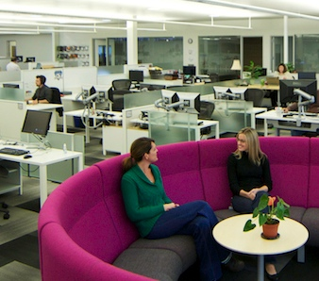

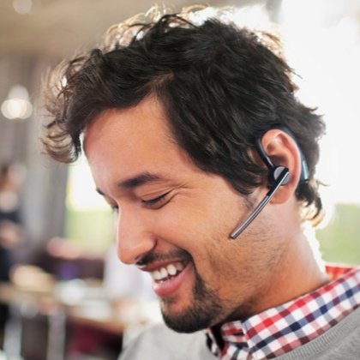
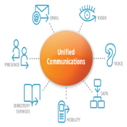
Collaborative
Workspaces
Systems, Tools,
Processes
Personas
Change Management

Slide 7
Collaborative
Workspaces

Slide 8


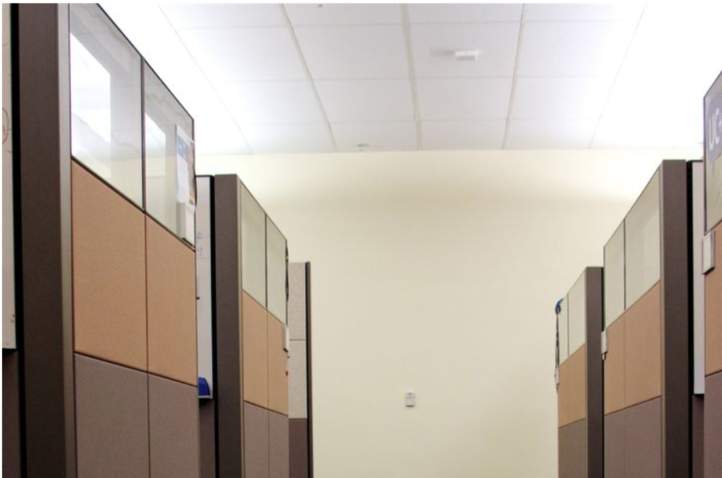
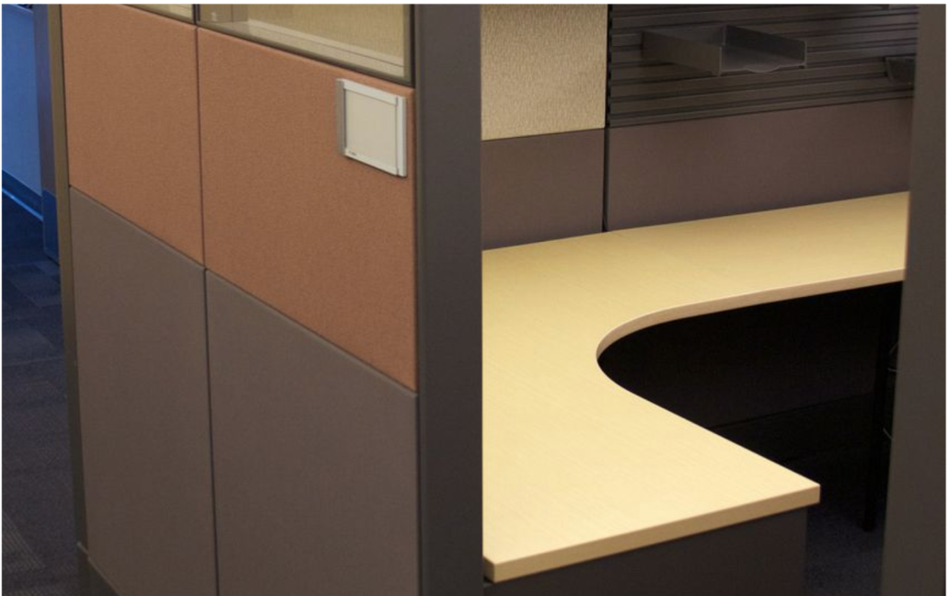
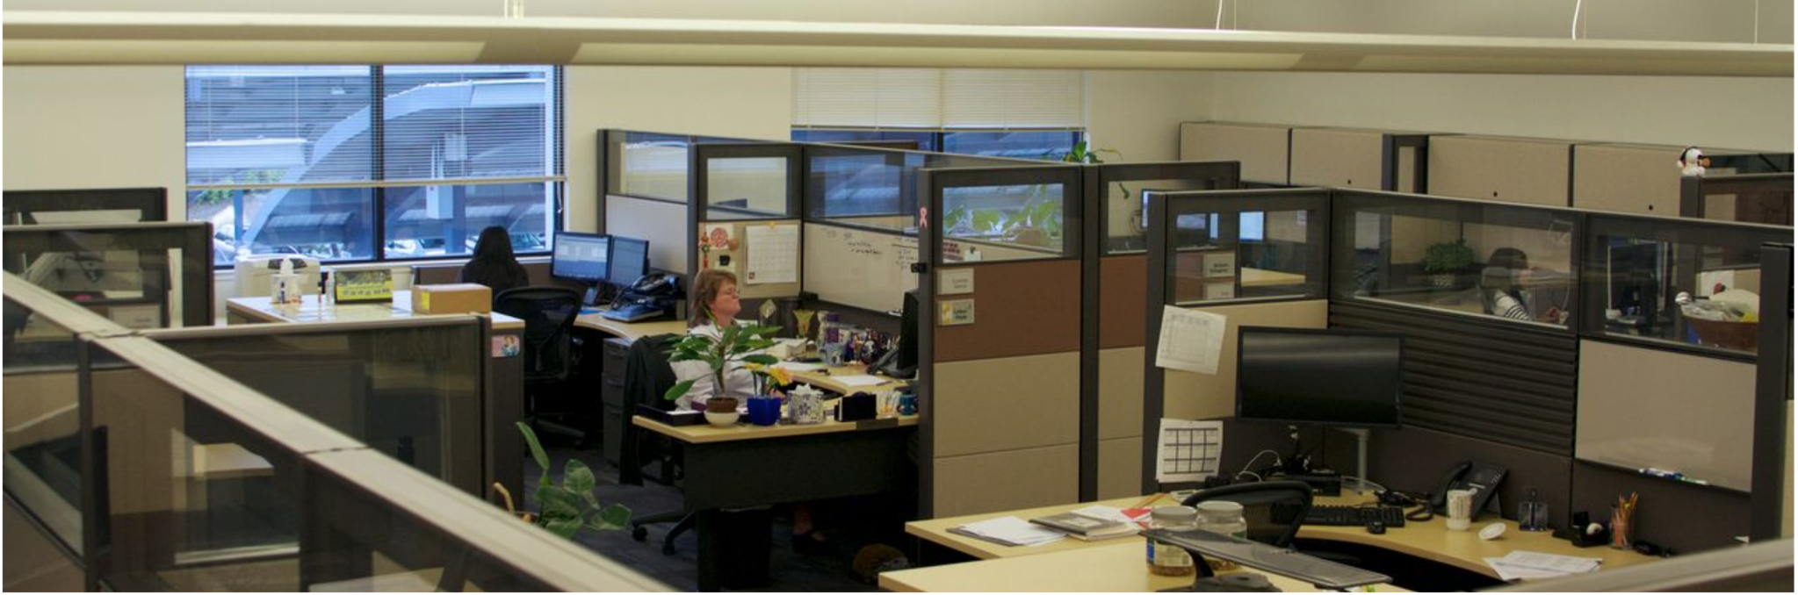

From Constrictive, Restrictive and Dark…

Slide 9
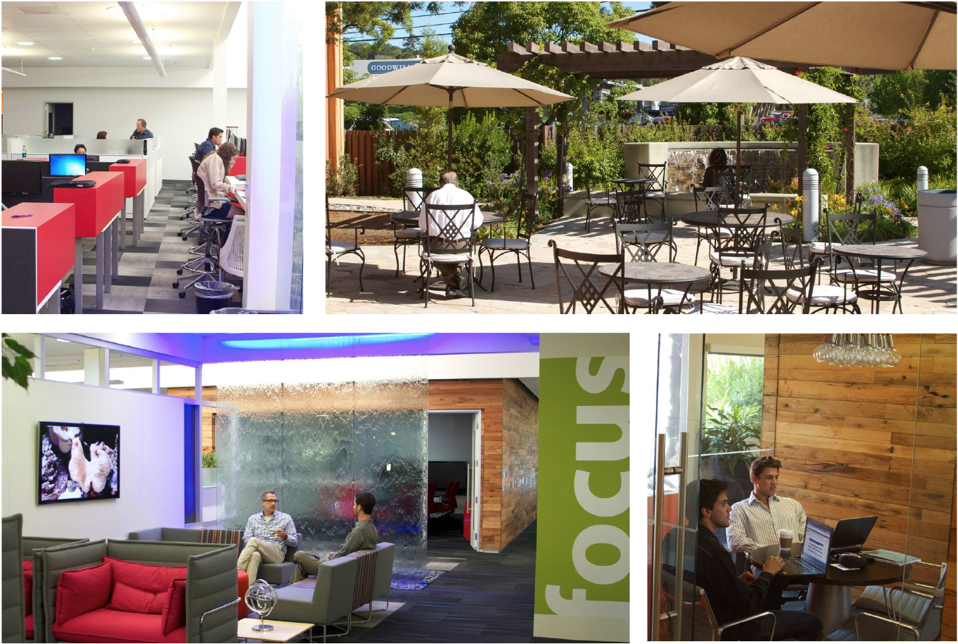
…To Collaborative, Flexible and Bright!

Slide 10
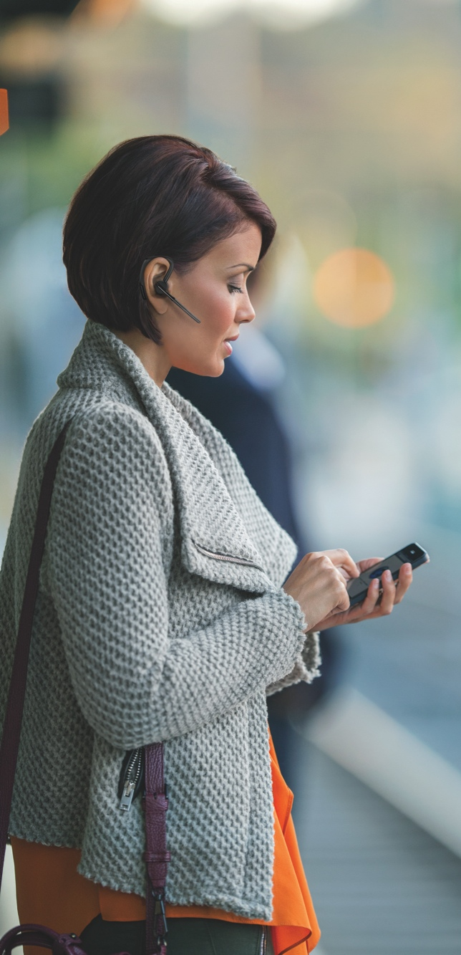
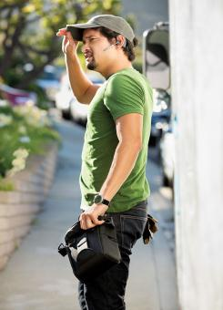
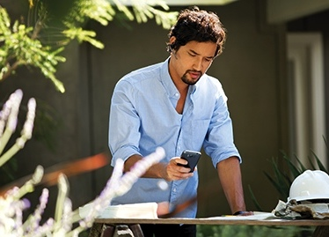
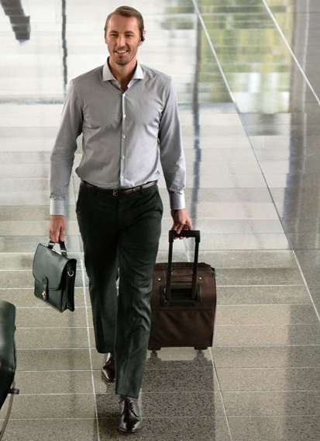

Collaborate, Connect and Get Work Done... from Almost Anywhere

Slide 11
What About Noise?

Slide 12
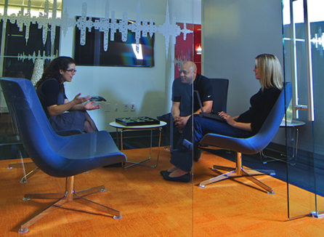
Not All Noise is Created Equal
10/8/2015
12

Slide 13

Noise has become the:
Research shows that it’s the intelligibility of speech, rather than the level or even the content of the speech that is most disturbing.
(Example: babble)
  Productivity
  Privacy
By eliminating background sound, many companies have actually made their workplaces too quiet to be acoustically comfortable
and productive.
  The “library” effect
#1 complaint of office workers
Densification Increases Office Noise
It’s not level that matters—it’s intelligibility
#1 challenge for workplace strategists
SPEECH IS WORST OF ALL

Slide 14

Sound Masking Helps Dramatically
Sound masking works by introducing a constant level of background noise to reduce speech intelligibility.
Two Kinds of Sound Masking
In-plenum
Direct Field

Slide 15
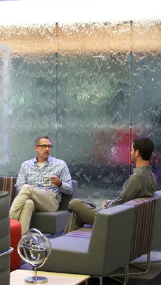
Plantronics Created a New Kind of Masking System
Mix of pink noise and
water sounds
Visual water element to encourage acceptance
Water sounds “mask
the masking”

Slide 16
Systems, Tools,
Processes

Slide 17
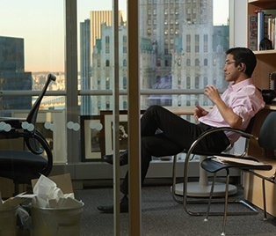
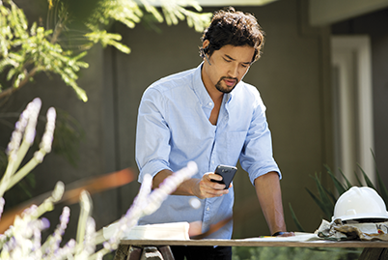
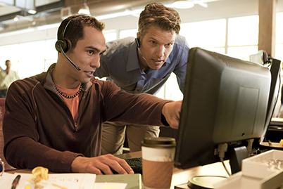
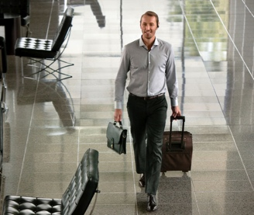
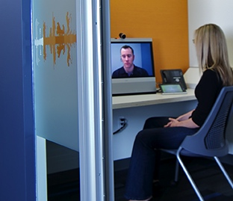
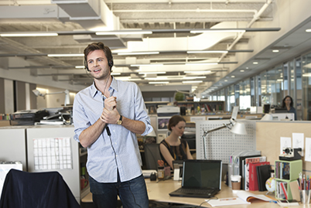
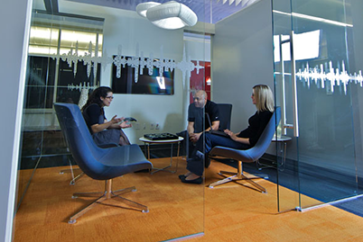


1
2
Unified Communications
Platform
Social Collaboration
Platform
Cornerstones
of a Smarter Working
Technology Ecosystem
Audio Devices
SMART Rooms &
Video Systems
4
3

Slide 18
Getting to Great UCC: A Journey
1
2007
LCS
2008
OCS
2009
OCS R2
IM/Presence
Peer-to-peer voice
Exchange 2003
Integration with Avaya CM
PSTN outbound via Net Gateway –
select associates
Federation
Application sharing
Live Meeting
PSTN outbound via Net Gateway – all associates
PSTN inbound via Net Gateway – select associates
Gateway redundancy
Exchange UM – migration
Exchange 2007

Slide 19
Getting to Great UCC: A Journey (cont.)
1
2011
Lync 2010
2011
Smarter Working
2013
Lync 2013
Online Meeting – enabled all Associates
Lync Mobile
Integration with
Avaya CM
PSTN inbound via
Net Gateway – all Associates
Exchange UM
SIP Trunking –
inbound conferencing
Exchange 2010
Lync + Jive + Sharepoint +
BYOD/BYOA
Along with
other unified communications solutions including video, social and mobile we’re now able to do something we call Smarter Working
Online Meeting enabled for all Associates – large meeting capacity
Intercall phased out
SIP Trunking – inbound conferencing – increased capacity
Exchange 2013
Smarter Working in full swing
10/8/2015
19

Slide 20

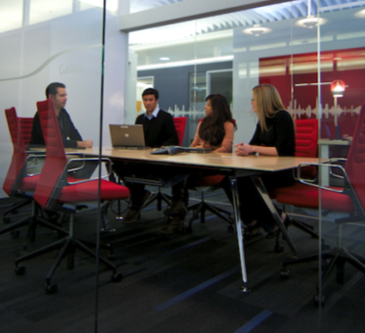
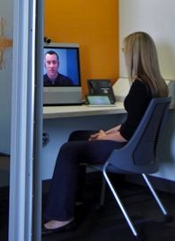
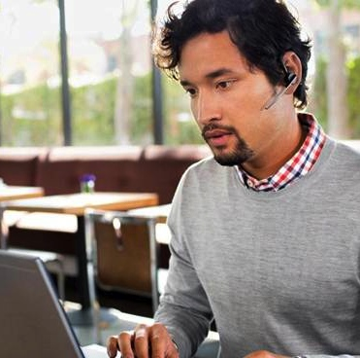
Social Platform – WAVE Built on Jive
2

Slide 21

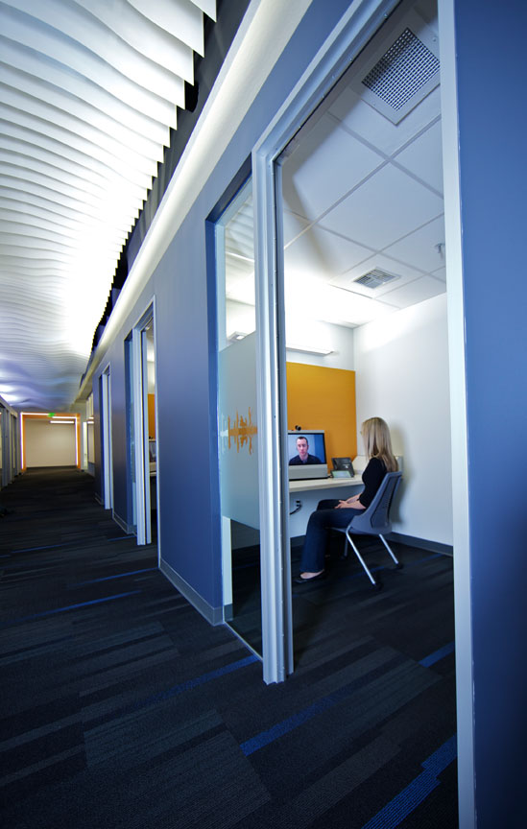
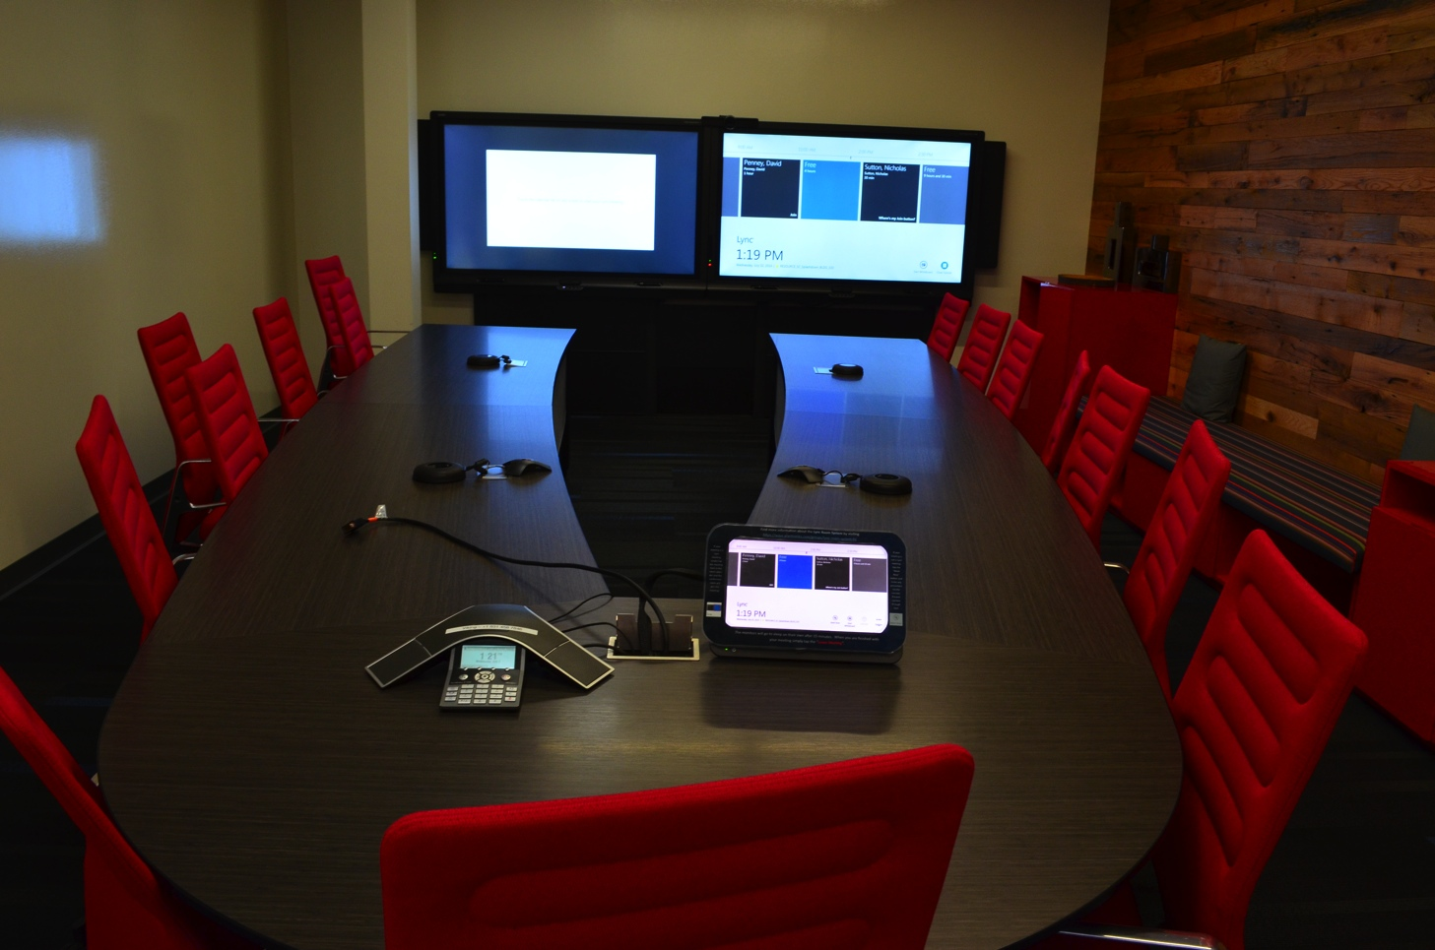

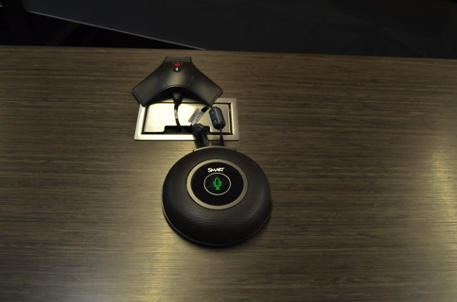
SMART Rooms and Video Systems
3

Slide 22
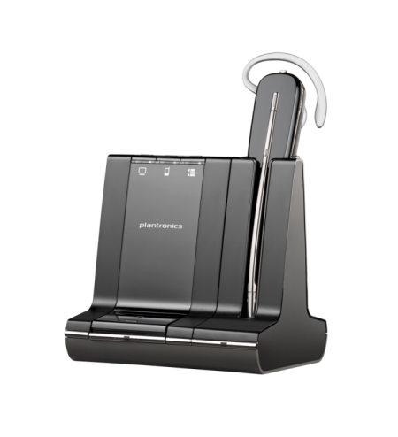
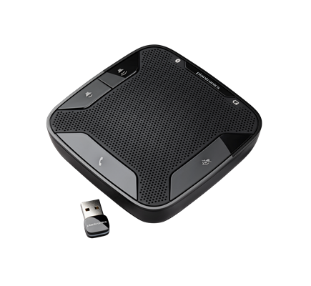
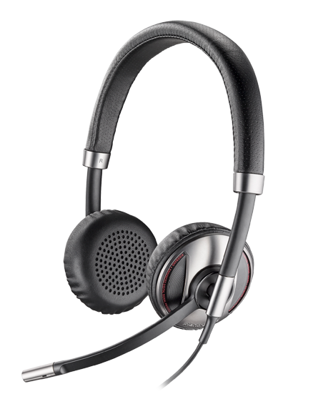
Unified Communications Portfolio
4
VOYAGER LEGEND UC
SAVI FAMILY
BLACKWIRE FAMILY
CALISTO FAMILY

Slide 23
Personas
Change Management

Slide 24
Understanding the Enterprise User
Notes:
In order to better understand enterprise worker behaviors, communication needs, pain points, etc., the following research was commissioned. This research was conducted in 2013 in Europe and North America with nearly 2,000 enterprise knowledge workers.

Slide 25



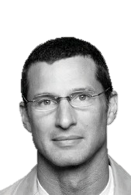

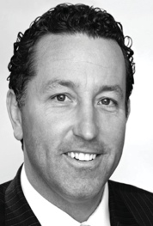
Meet our Enterprise Personas
 | Persona | Work Environment | Communication Needs | Pain Points
 | Carl Manning Connected Manager SAP Integration Director- BMW | On the move inside the office Travels to other company locations | Smartphone, tablet, Pc Conference calls, txt, IM, email & F2F equally | HF for conference calls Transition between devices Quality connections Battery life
 | Fay Ramos Wyatt Flexible Worker Account Director- Ogilvy & Mather | Home Office Client sites Corporate office | Smartphone, laptop, landline Social media Quick seamless response to calls, txt, emails | Unpredictable noise & interruptions Needs BT Does not like HS, messes hair Loud environments
 | Dirk Wallace Desk Worker Purchasing Agent- Multilink | Sits at desk most of day | Uses PC & desk phone Smartphone is personal device | Too diverted from work by distractions No privacy Uncomfortable holding handset to ear on long calls
 | Olivia Calhoun Office Worker Project Assistant-Quaprotek | At my desk On the move around the office | Primarily desk phone Emails and in person meetings | Takes too long to get information Ambient noise level Distractions
 | Ray Walich Road Warrior Regional Sales Manager Glaxo Smith Kline | Travels frequently Portable Office Multiple locations & many transitions | Smartphone is primary Always connected Connects to multiple devices: PC, Car, Tablet | How do I sound Quality Connections Transition between devices & environments

Slide 26
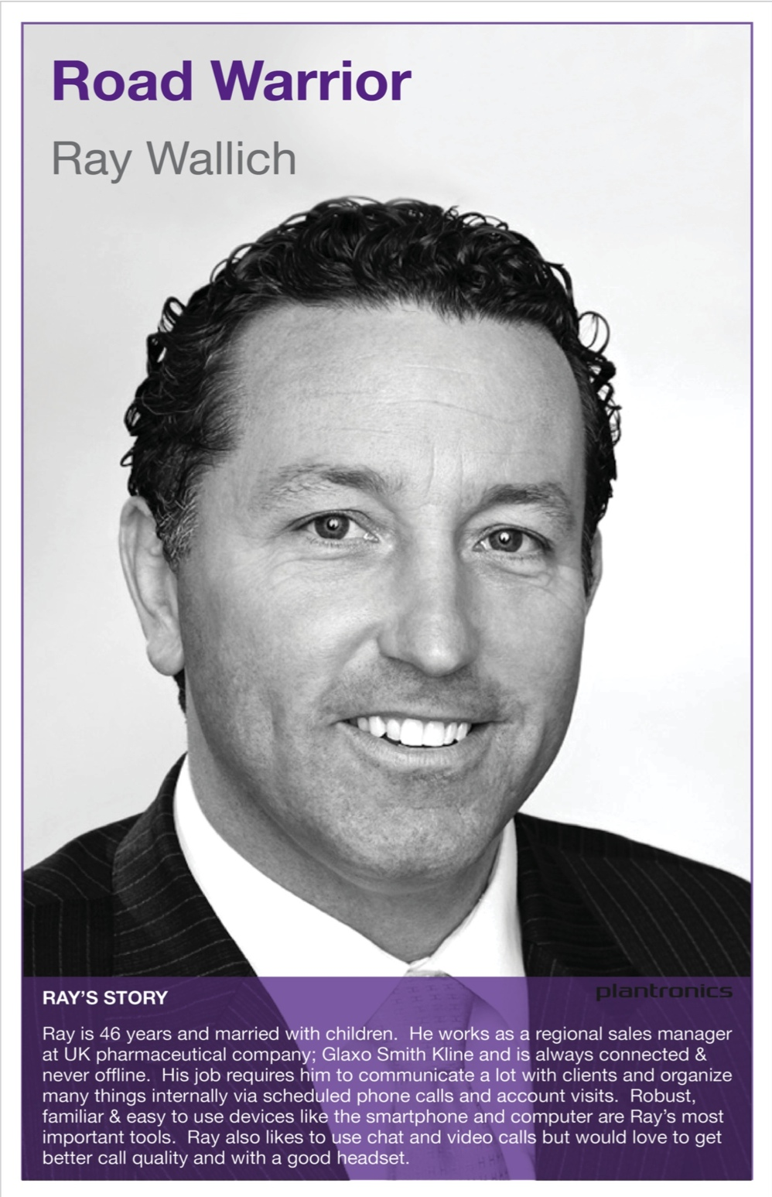
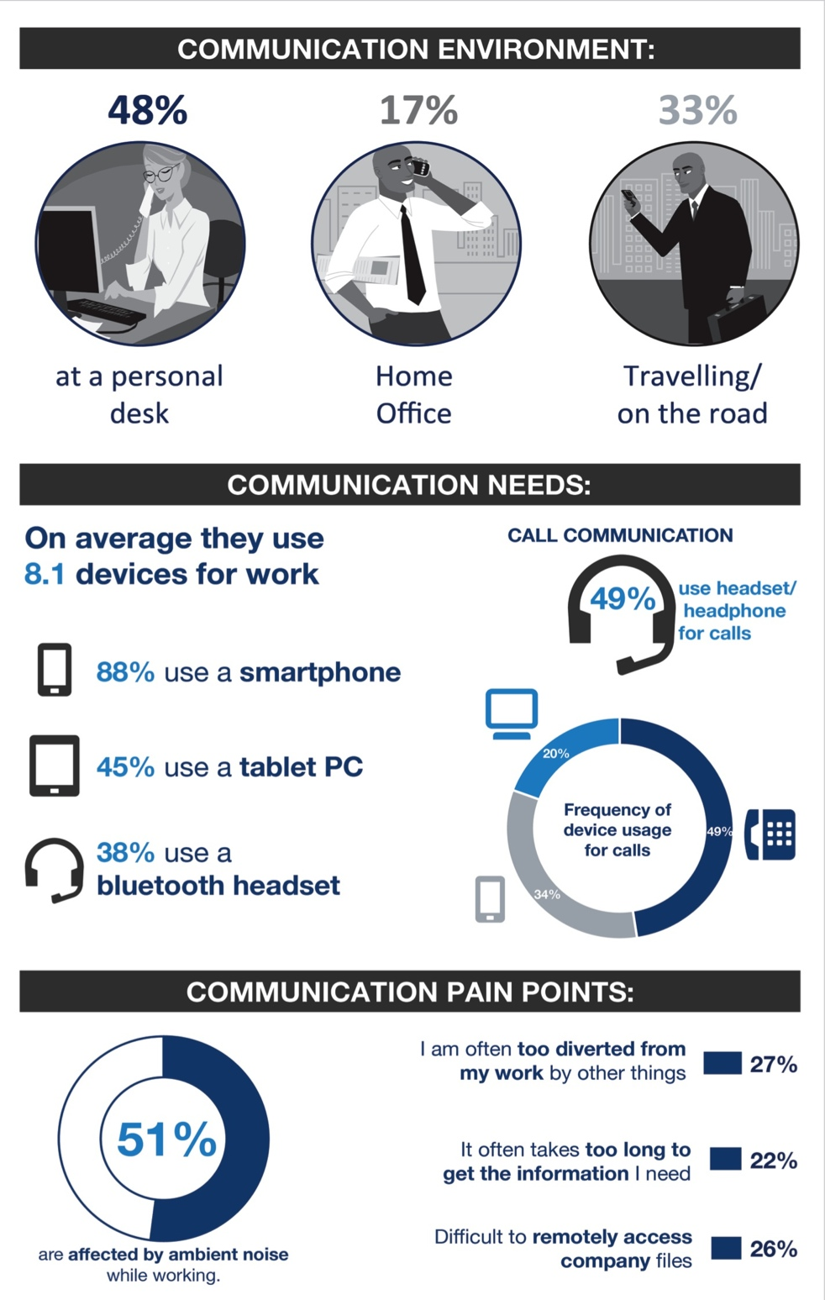
8% of Global

Slide 27
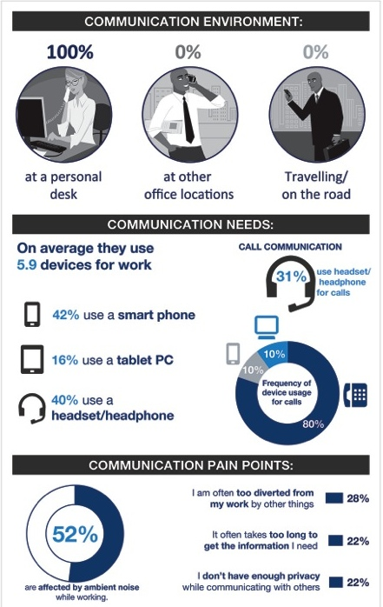
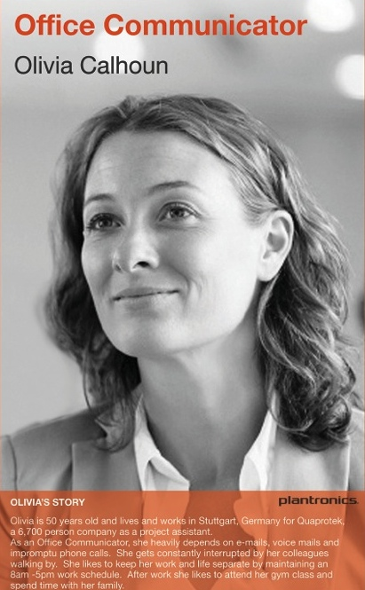
12% of Global
8 % of Global

Slide 28
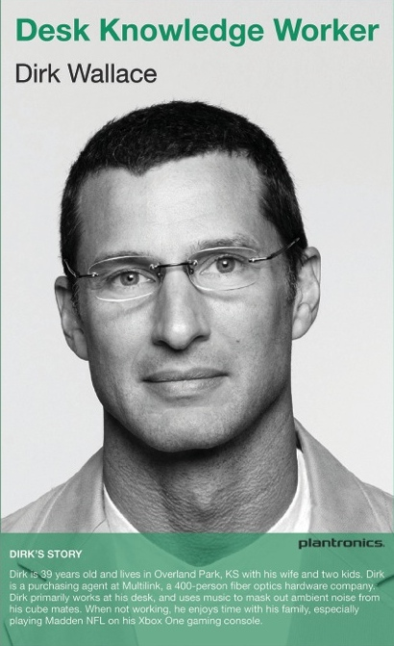
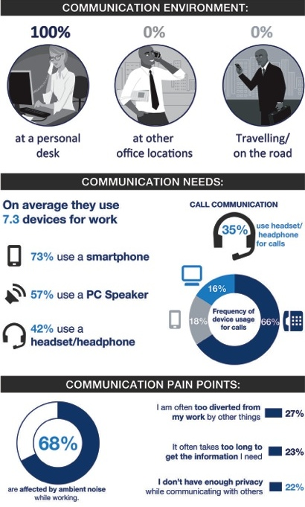
21% of Global
8 % of Global

Slide 29
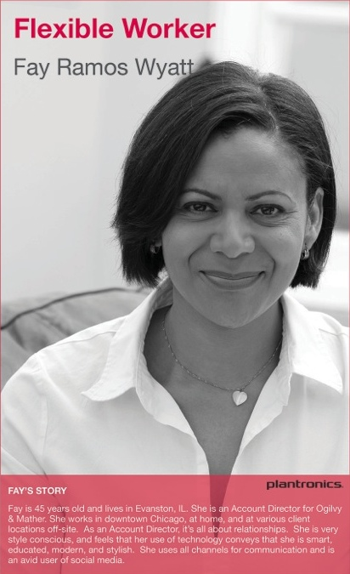
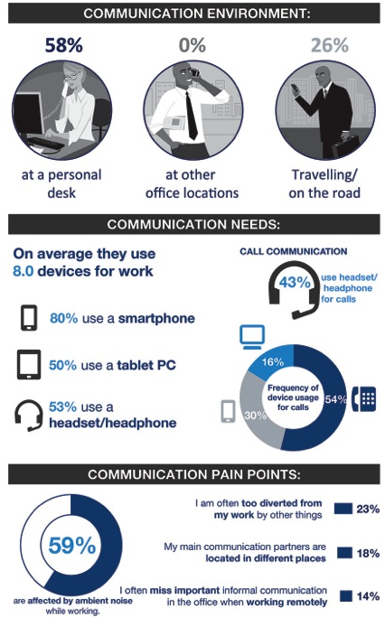
17% of Global
8 % of Global

Slide 30
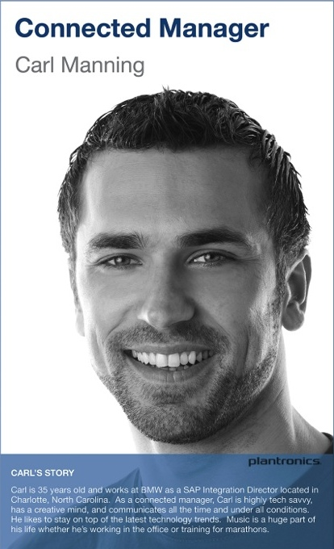
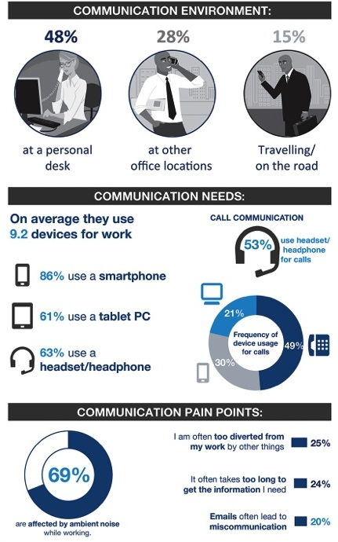
18% of Global

Slide 31

Change Management
Communications
Training
Support

Slide 32
Wrap-up and Key Learnings

Slide 33
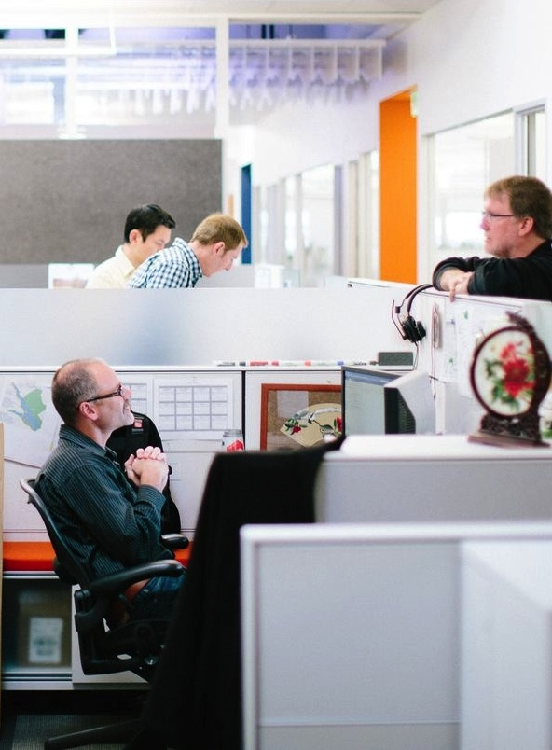
Consider Flexible Space
  Encourages…
  Communication
  Collaboration
  Focus
  Creativity
  Sharing/Support

Slide 34

Assess Your Network
  Includes LAN, WAN
  and WiFi
  You’ll need adequate
  capacity and QoS
  Check for WiFi density
  issues if moving to
  smaller area with
  many mobile users

Slide 35

Tailor Your Training
  Boomers want classroom style and 1:1 coaching
  GenX want online learning
  at their own pace
  Millennials simply “figure
  it out”

Slide 36

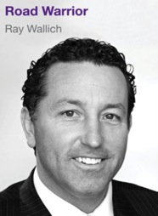
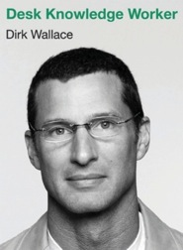
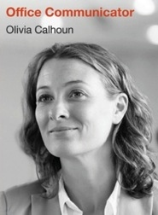

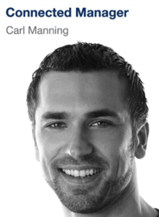
Pair the RIGHT Audio Device with Use Case
  Ensures optimal
  focus and best
  collaboration experience

Slide 37
The Most Effective Workplaces
Balance Focus and Collaboration

Slide 38




A Collaborative Workplace…
Eliminates silos; encourages transparency and
information sharing
Provides spaces, tools, and technologies that enable clear communication, personal focus, and team collaboration

Slide 39


